Slide 1
INTRODUCTION TO WEB DEVELOPMENT
DAY 1

Slide 2

What is WEB?

Slide 3
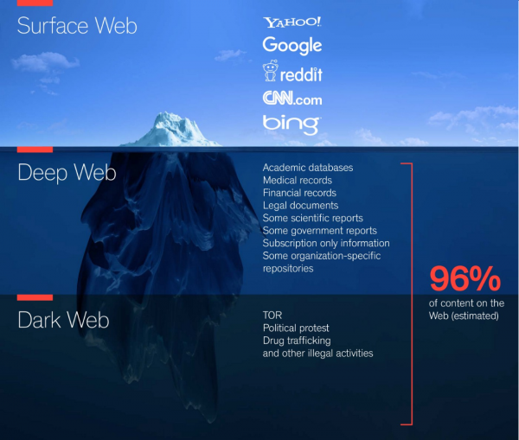
What is WEB?
It refers to the websites or webpages or anything that work on the internet.
The term "web" typically refers to the World Wide Web (WWW).
It was created by Sir Tim Berners-Lee in 1989 and became publicly accessible in 1993.
The web consists of millions of web pages and websites that are connected through hyperlinks, allowing users to navigate between them by clicking on links.

Slide 4
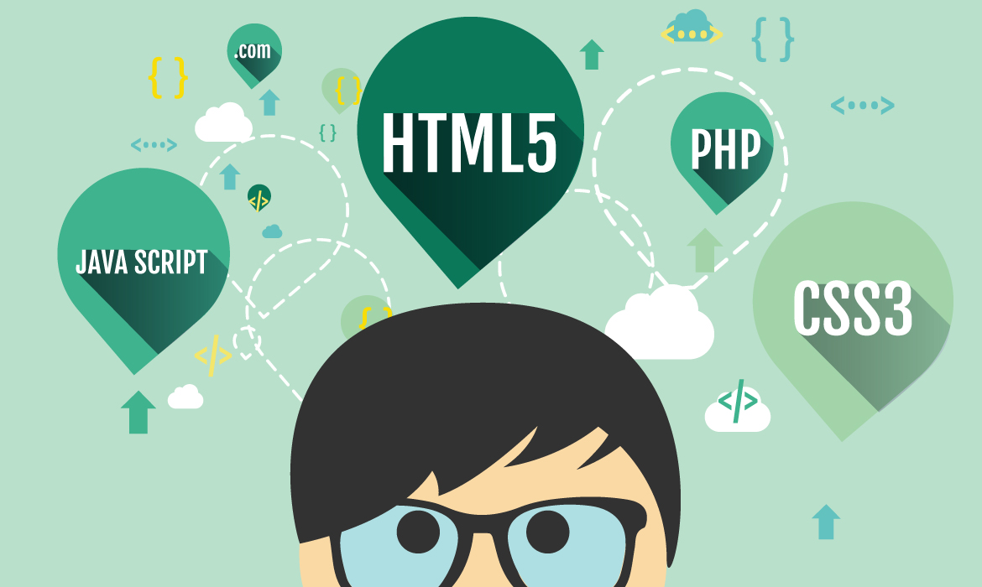
What is WEB DEVELOPMENT?

Slide 5
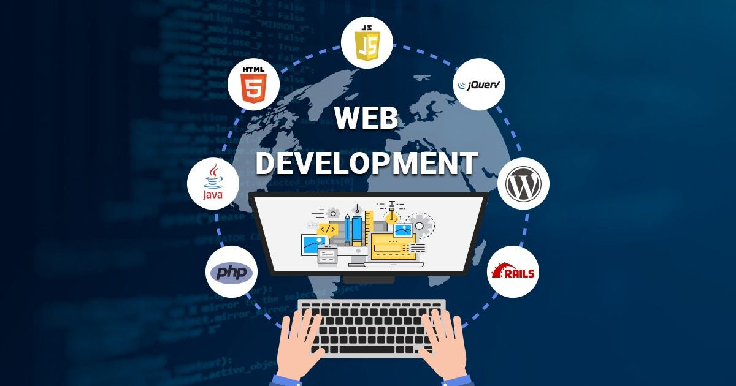
WEB DEVELOPMENT
Web development is the process of creating websites and web applications that can be accessed over the internet.
It involves designing, building, and maintaining digital experiences that users interact with through web browsers.

Slide 6
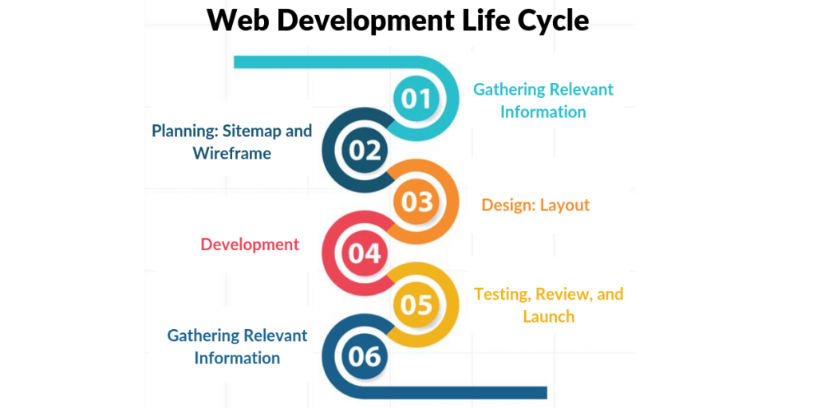
WEB DEVELOPMENT
It is refer to the development of the Websites, building, creating and maintaining the websites.

Slide 7
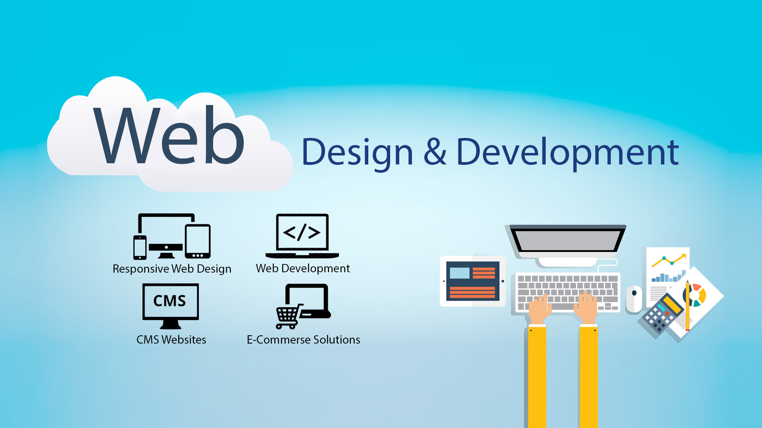

Slide 8
WEB PAGES
First created by Tim Berners Lee on August 6,1991
What we seen in the web browser.
Its an HTML document that contains html tags
It can accessed through the browser by entering the URL address.
It contains text, images, video etc.
A webpage as a single document of any website

Slide 9
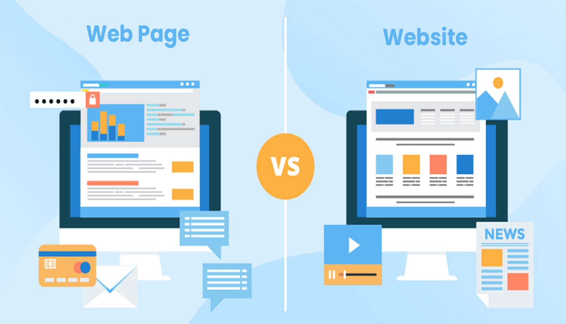
WHAT IS THE DIFFERENCE BETWEEN THE WEBPAGES AND THE WEBSITES?
Website is the central location for containing more than one webpages.

Slide 10
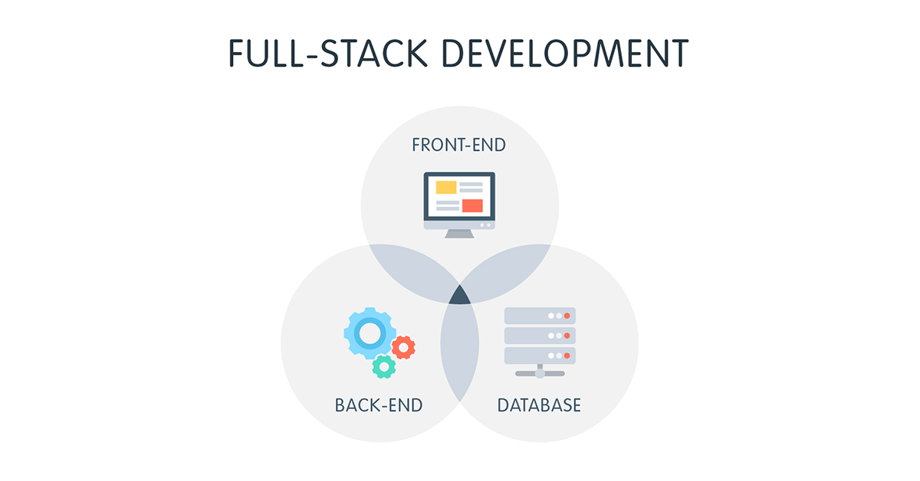

Slide 11
Why Full Stack Web Development?
Full Stack Development is a software profession/stream where a developer deals with both the Frontend (client-side) and Backend (server-side) of a tech product.
A Full Stack Developer is proficient in several technologies that help in developing a robust tech product, and thus play a major role in making decisions for the company.
It is one of the high-demand jobs in the software industry.

Slide 12
What is the job of a Full Stack Developer?
Full-stack developers develop both the front-end and the back-end of the application, deploy, debug and maintain their databases and servers.
Being a Full Stack Web Developer, you will be at an edge as you make better technical decisions .

Slide 13
What skills are required to become a Full Stack Developer?
HTML, CSS, UI & UX, JavaScript, etc.
Server-side languages such as JavaScript, Python,Java, etc.
Frameworks Express, Spring Boot, Django, etc.
Along with an understanding of System Design, Data Structures and Algorithms, Databases, and version control systems like Git.

Slide 14
Who Is full stack Developer?
Full Stack Developer is an engineer who can work on different levels of an application stack.
The term stack refers to the combination of components and tools that make up the application.
The components could be in the front-end or the back-end of the system.
The main objective of full stack engineer is to keep every part of the system running smoothly.

Slide 15
Web development teams and roles
Web Designer
Front-End Developer
Back-End Developer
Full-Stack Developer
Content Developer
Webmaster
Other stars

Slide 16
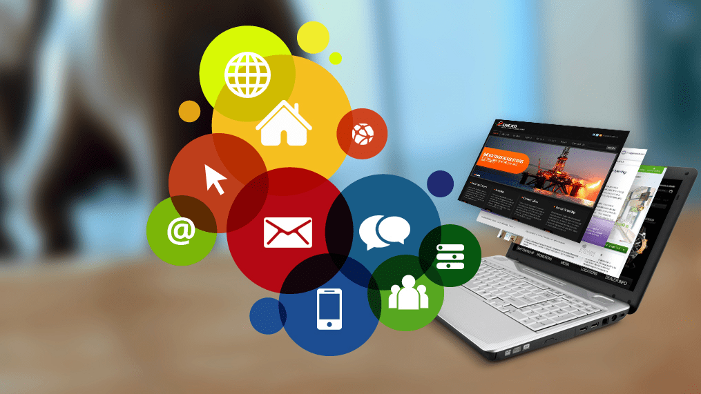
WEB APPLICATIONS

Slide 17
WEB APPLICATIONS
A web application is a computer program that utilizes web browsers and web technology to perform tasks over the Internet.
Eg: facebook, Ig, LinkedIn, Youtube, Flipkart etc

Slide 18
User Request:
The user initiates a request, typically by interacting with a web browser or the application's user interface.
Web Server Handling:
The web server receives the user's request and determines the appropriate action.
Forwarding to Web Application Server:
The web server forwards the request to the relevant web application server that is capable of handling the specific task requested by the user.
Task Execution:
The web application server performs the requested task. This may involve querying a database, processing data, or any other necessary operations.
Result Generation:
After executing the task, the web application server generates the results, which may include data or information requested by the user.
Sending Results to Web Server:
The web application server sends the results back to the web server.
Client Response:
The web server responds to the client (user) with the requested information or processed data.
User Display:
The client (user's device, such as a web browser) receives the response from the web server and displays the requested information to the user.

Slide 19
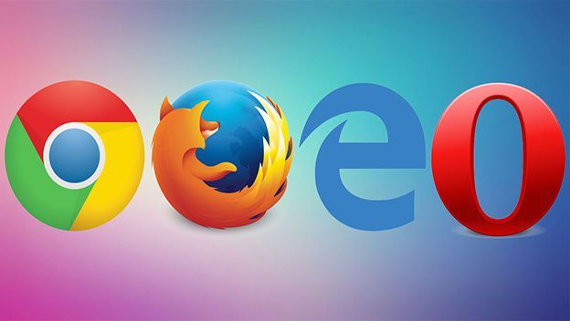
WEB BROWSERS
Application software for accessing website.
It retrieves the information and displays the information over the desktop.
Information is transferred using the Hypertext Transfer Protocol (HTTP)
e.g.: Firefox, Chrome, edge etc

Slide 20
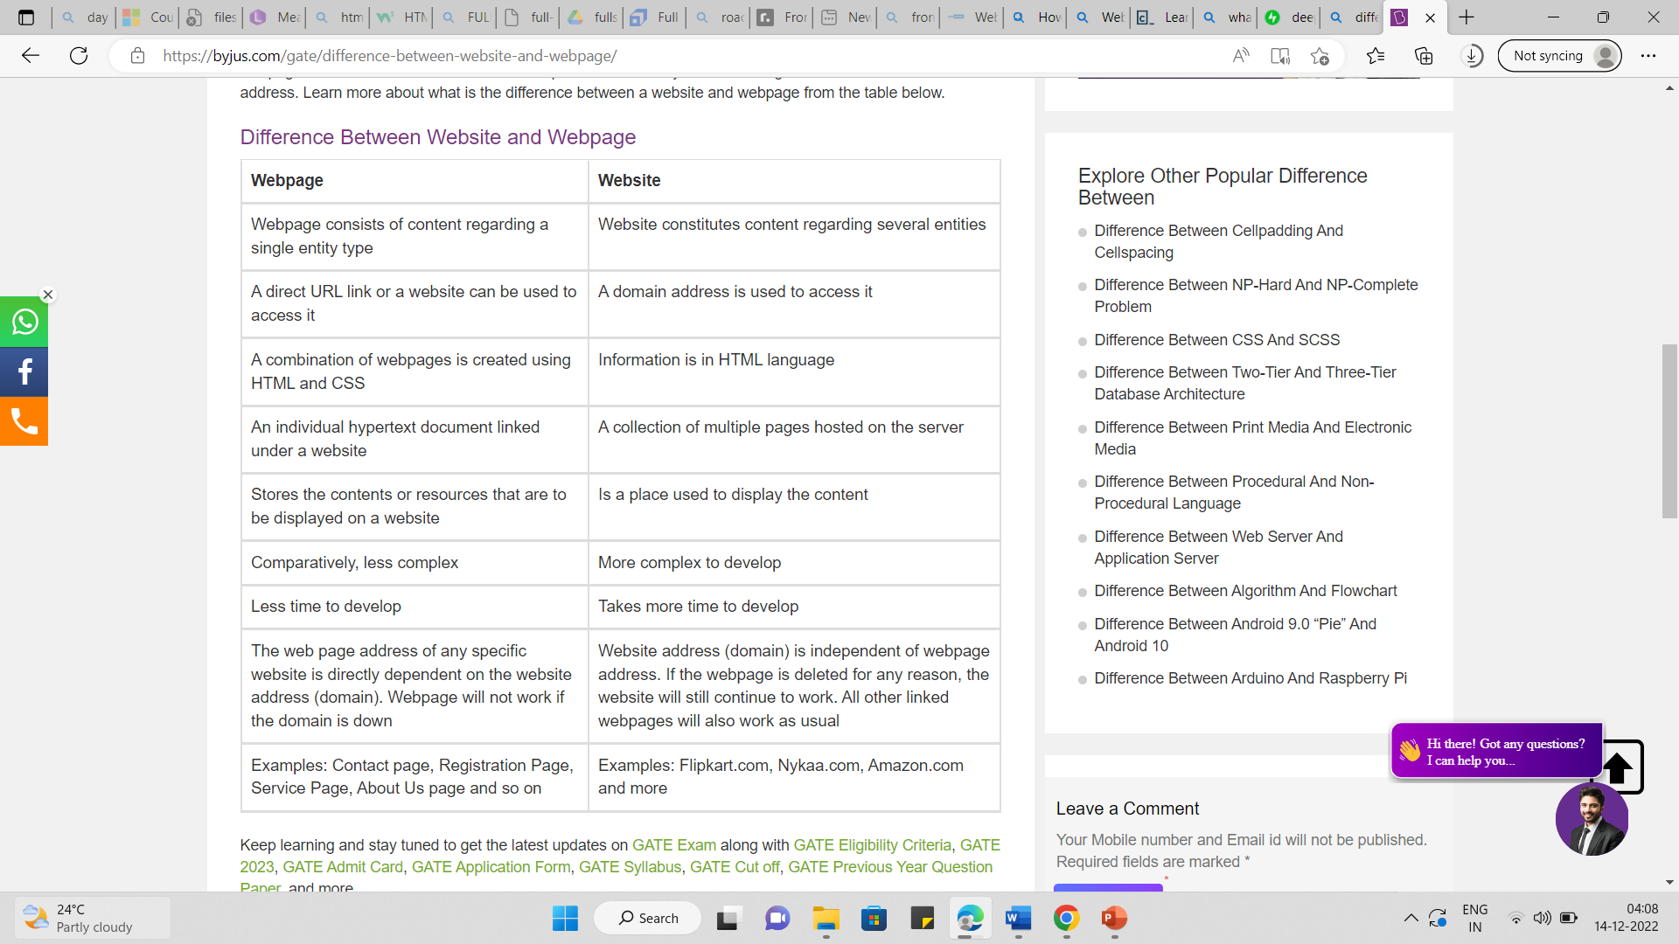

Slide 21
Modern Application Architecture
Modern applications are developed to be installed on mobile devices or hosted on the web.
System parts
Back-End – Operating System (OS) – Firewall – Web server – Database (SQL or NoSQL) – Caches – Message Queuing software – Application
Front-End – HTML – CSS – JavaScript

Slide 22
Modern Front-End frameworks
We have seen the big shift in the web from HTML 4 to HTML5 which has built-in APIs to help you accomplish many tasks to built a richer web application.
This has resulted in a variety of front-end MVC frameworks such as:
AngularJS ….(Currently we are using Angular)
React Js

Slide 23
Modern Development Frameworks
The changing computing world has led to and been led by the fast growing world of web development frameworks such as:
NodeJS
Django

Slide 24
WEB DEVELOPMENT CAN BE CLASSIFIED INTO TWO WAYS
FRONTEND(CLIENT SIDE)
BACKEND(SERVER SIDE)

Slide 25
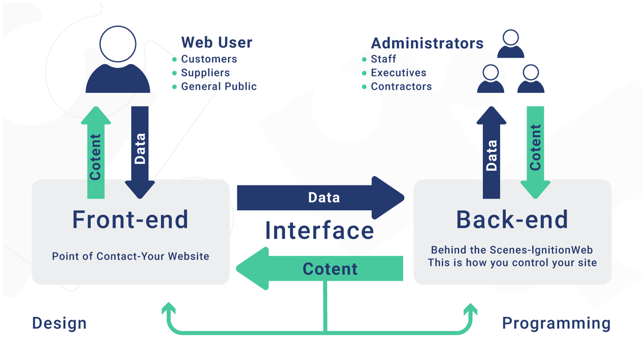

Slide 26
1.FRONTEND(CLIENT SIDE)
What we seen on the screen.
The part of the screen that users can interact directly.
Provide the view of web application.
Frontend Technologies - HTML, Angular, React
e.g.: login page of Facebook.

Slide 27
HTML, CSS, JS and bootstrap
HTML
HYPERTEXT MARKUP LANGUAGE (Skelton of webpages)
CSS
CASCADING STYLE SHEET(Styling the web page)
JS
JAVASCRIPT(Dynamic behaviour)
BOOTSTRAP
(Advanced styling)
know about bootstrap follow this link: https://getbootstrap.com/docs/5.0

Slide 28
Duties of frontend
Providing the view of the frontend.
Data send to the server.

Slide 29
BACKEND(SERVER SIDE)
It is the part of the website that users cannot see.
It is the portion of software that does not come in direct contact with the users.
It is used to store and arrange data.
Technologies -java, python, .net, Nodejs

Slide 30
Duties of backend
Client request handle and process
Request to Data base.
Request send back to the client

Slide 31
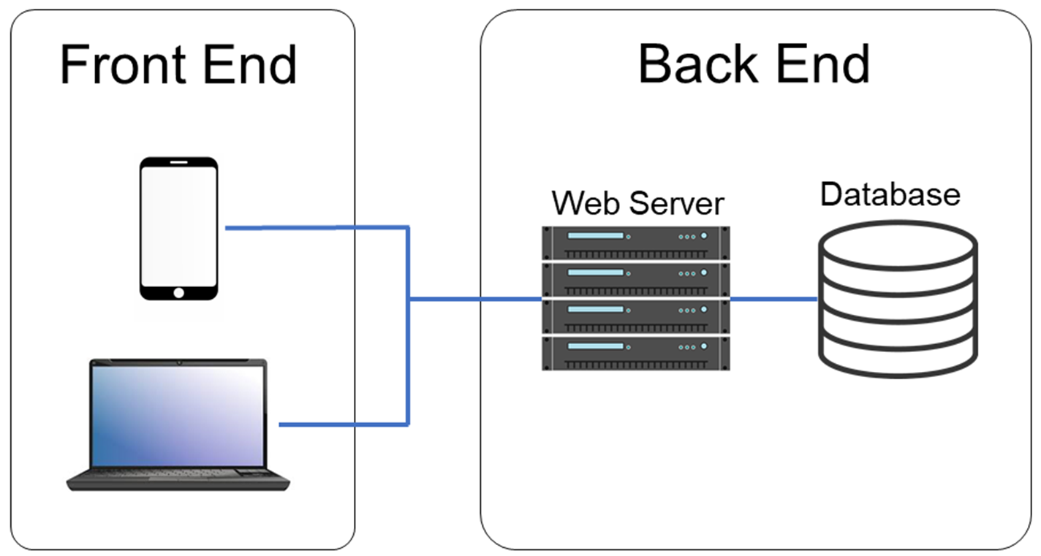

Slide 32

React
React is a JavaScript library for building user interfaces.
It is used to build single-page applications.
It allows us to create reusable UI components
React was released by Facebook in 2013, and they still use it today for many of their applications.
https://reactjs.org

Slide 33

Angular
Angular is an open-source, JavaScript framework written in TypeScript.
Google maintains it, and its primary purpose is to develop single-page applications.
Official site : https://angular.io

Slide 34
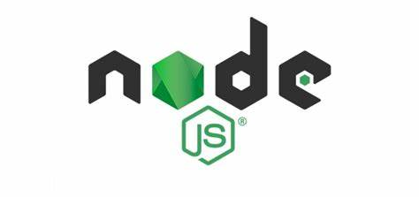
Nodejs
It is a Runtime environment.
It allows run JavaScript on the server.
https://nodejs.org

Slide 35

EXPRESS
It is a NodeJS framework.
It provides us the tools that are required to build our app.
Site: expressjs.com

Slide 36
FRAMEWORK
It is a prebuilt functions for the various purpose.
Frameworks are typically associated with a specific programming language and are suited to different types of tasks.

Slide 37
DATA BASE
It is mainly used in dealing with website information.
Primary function of it deals with storing, updating, creating and deleting data.(CRUD)
e.g.: Validate the email id and password existing or not.
Technologies: MySQL, MONGODB etc

Slide 38

MONGODB
MongoDB is a powerful, highly scalable, free and open-source NoSQL based database.
Widely used across various web applications as the primary data store.

Slide 39
WHAT IS DATA
Its a small unit of information which helps to manipulate the information in many ways.
It can take many forms like: text, audio, video, image, gif etc.

Slide 40
WHAT IS METADATA
Data about data
It helps people understand the essential attributes of data, like its origin, time period, geographic coverage, etc.
Meta data is always valuable

Slide 41
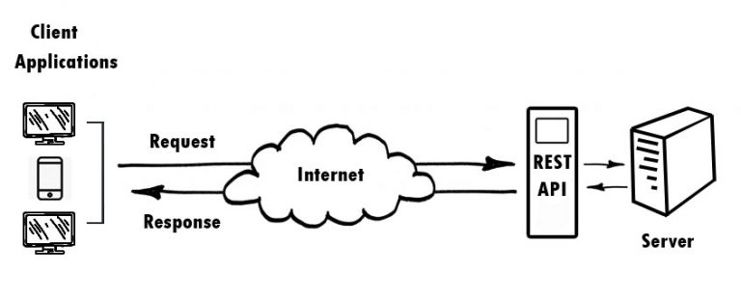
How to connect the client and server systems?
This can achieved by using the API.

Slide 42
API (APPLICATION PROGRAMMING INTERFACE)
It is a set of functions that allows applications to access data
To simplify, an API delivers a user response to a system and sends the system’s response back to a user.
This communication is done using a programming language called “JSON.”
e.g.: act like waiter

Slide 43

JSON(JavaScript Object Notation)
Data sharing on network using very faster methods - XML, JSON
It is used to represent data on a server.
It’s fairly easy to read by humans, and easy for machines/applications to understand.
This is easy to understand as it’s outputted in key/value pairs.

Slide 44
PROTOCOLS
It is a set of rules for sending data.
A protocol is a standard for enabling the connection, communication, and data transfer between two places on a network.
e.g.: FTP,HTTP

Slide 45
HTTP - (Hypertext Transfer Protocol)
It is for transmitting hypermedia documents, such as HTML.
HTTP follows a client opening a connection to make a request, then waiting until it receives a response.
Head - Confidential data
Body - Data to share with the server.

Slide 46
The http methods for CRUD operations
GET – Gathers information
PUT – Updates pieces of data
POST – Creates the new data
DELETE –Delete pieces of data

Slide 47
WHY WE USE CERTAIN SET OF TECHNOLOGY?
All the technologies we used in MEAN is based on JavaScript.
MEAN/MERN uses only JavaScript and therefore is the universal language of development.
This can significantly reduce the cost and effort spent on coding since two separate teams won’t be required for the front-end and back-end separately.

Slide 48
Other Things
Virtual Machines will help you set up a fresh development machine on which you can build the environment that you need for your project.
Command Line Interface will give you the tools you need to interact with your development machine and environment directly or remotely, with or without a GUI. Software Package Managers will introduce you to the tools that will help you manage and set up the software in your development environment.
Editors and IDEs will give you the ability to create and edit files in your development environment.
DEVELOPER TOOL - are built directly into the browser. These are the tools that are browser dependent. Most of these tools are common among various browsers and do a range of things, from inspecting elements of a currently-loaded HTML, CSS, and -JavaScript. With developer tools, we can directly interact with the source code that is fetched into the client side of our system.

Slide 49

Thank You

